Slide 1


Property Renewal
September 23, 2024 9:00am
PRESENTER:
Tara Washington
Alliant Insurance Services

Slide 2
Agenda
Renewal Packet
AlliantConnect – tutorial available on PRISM Website
Renewal Timeline
Submitting to PRISM
Deductible Option Requests
Notes:
Todays’ agenda consists of discussing renewal packet along with applicable attachments, AliantConnect, the renewal timeline and when it’s due to PRISM

Slide 3
Renewal Packets
Renewal Confirmation Checklist
EQ Certification Form
Vehicle Valuation Form
Mobile Equipment Valuation Form
Library Book Valuation Form
Vacant Buildings?
Any COC’s (Course of Construction)?
Notes:
The Alliant Property Team has emailed renewal packets to each property member. Please send me an email after the webinar if you have not yet received your packet. These renewal packets are in essence your property program renewal application. Updated information is imperative as it assists in determining your premium. The packet includes the following:
Checklist – Lists all items necessary for completion
EQ Certification Form- this form is for members who purchase EQ coverage for specific locations. Vehicle, Mobile Equipment and Library Book Valuation are guides members can use as tools when updating their property schedule
This year, we are asking members to pay close attention to any buildings reflected as “Vacant” that might now be occupied and/or COC’s now completed. Please be sure to notate either of these items on your confirmation checklist

Slide 4
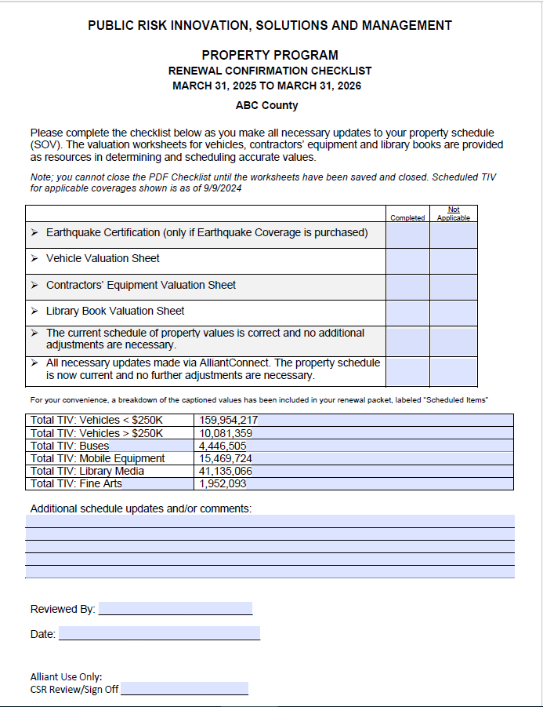
Renewal Confirmation Checklist
Notes:
First document is the Checklist – this lists all items necessary for completion with a section for additional updates or comments regarding your current schedule. If applicable, your packet will include an EQ certification sheet with corresponding SOV. All packets come with a Vehicle, Mobile Equipment and Library valuation worksheet.

Slide 5
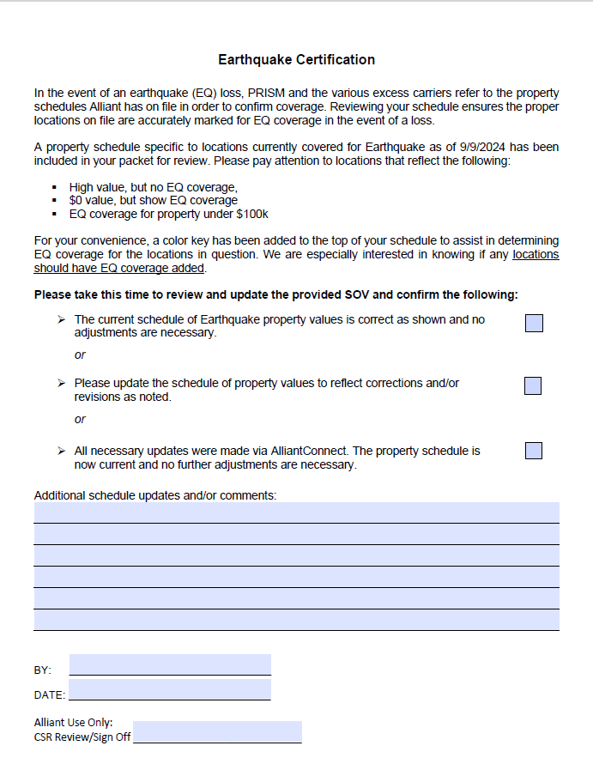
EQ Certification
Notes:
EQ Certification Form- this form is for members who purchase EQ coverage for specific locations. Members are required to review their property schedule and certify their EQ coverage is presently accurate, or if EQ should be added or removed from certain locations. The Alliant team has included a property schedule highlighting locations currently covered for EQ in the renewal packet. All TIV values are as of August 20th.

Slide 6
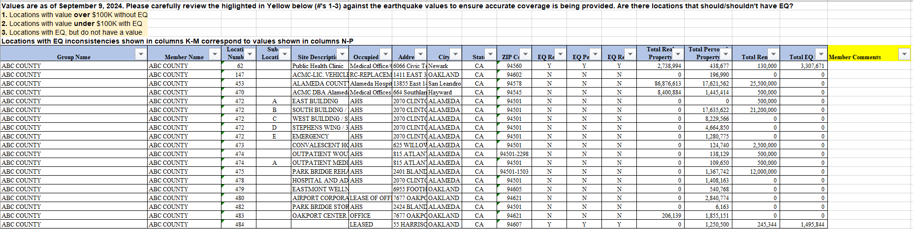
EQ Confirmation Sheet Example
Notes:
EQ Certification Form- this form is for members who purchase EQ coverage for specific locations. Members are required to review their property schedule and certify their EQ coverage is presently accurate, or if EQ should be added or removed from certain locations. The Alliant team has included a property schedule highlighting locations currently covered for EQ in the renewal packet. All TIV values are as of August 20th.

Slide 7
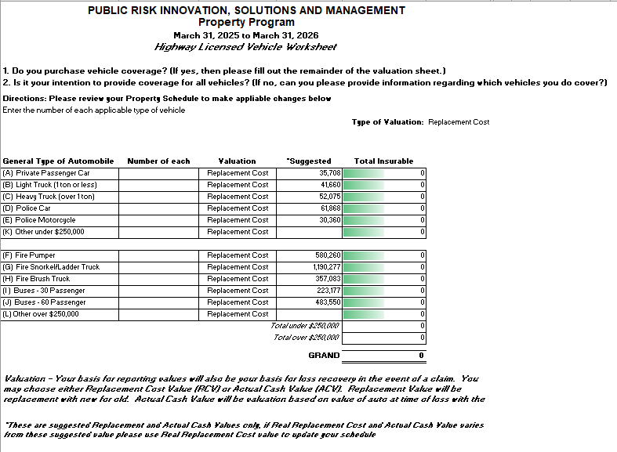
Vehicle Valuation Sheet
Notes:
Vehicle, Mobile Equipment and Library Book Valuation are guides members can use as tools when updating their property schedule

Slide 8
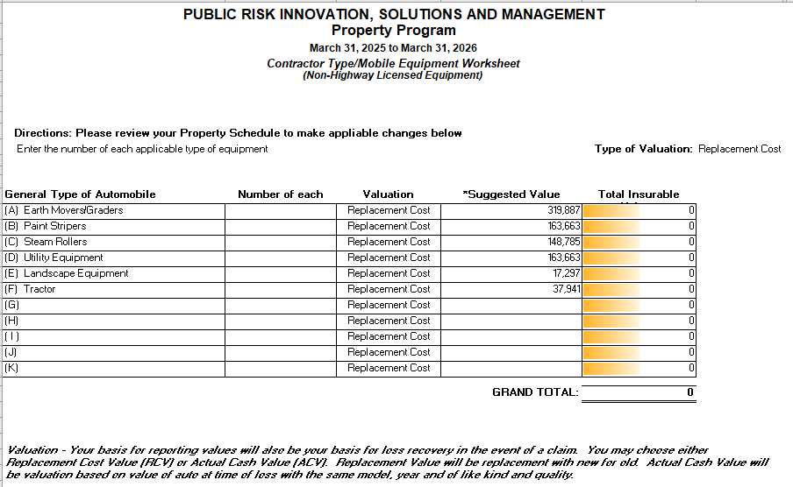
Mobile Equipment Valuation
Sheet
Notes:
Mobile Equipment

Slide 9
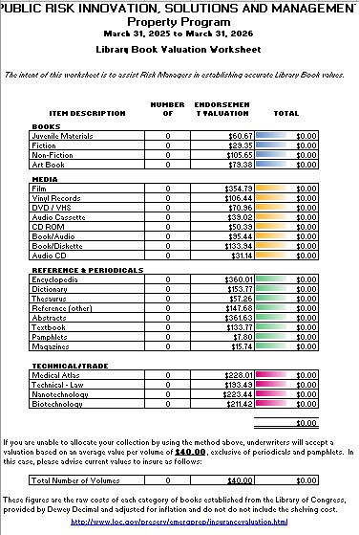
Library Book Valuation Sheet
Notes:
Library Book

Slide 10
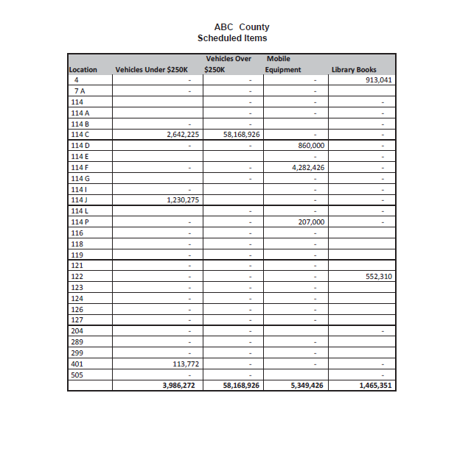
Scheduled Items
Notes:
Scheduled items goes hand in hand with your valuation worksheets and will assist you in navigating straight to these locations on your schedule. Here is an example of what you would receive if applicable to you. This list will show you the location number and value of the scheduled item, with the totals at the bottom for each category of scheduled items

Slide 11
Questions?

Slide 12
PRISM Renewal Timeline Policy Statement
Every year, a detailed market submission is prepared so that the Property Program can be marketed on a world-wide basis. The market submission includes details on the structure of the Program, coverage terms, and the detailed electronic schedule of values from every member. Timely submission of renewal data by members is essential to ensure that the market submission is complete and accurate. The following Renewal Timeline Policy Statement is hereby established and the program renewal deadlines are as follows:
Deadline for changes to the Schedule of Values
Alliant will request members review and approve the accuracy of their schedule of values annually in the fall prior to the renewal. Members must submit changes to the schedule of values and/or verify the accuracy of the schedule by November 1st.
Penalty: A 10% surcharge will be added to the premium allocation formula for the coming renewal. There will be an automatic 15-day grace period following the deadline for members who are still working with Alliant and PRISM staff to finalize their schedule of values. After the 15 day grace period, the penalty shall apply. The penalty cannot be waived except by action of the Property Committee
Deadline for changes to the Schedule of Earthquake Values
The marketing of the Program is heavily dependent on the extent of earthquake coverage required. Consequently, specific requirements are necessary relative to earthquake coverage and members that buy earthquake coverage. Significant changes to the earthquake values scheduled may affect the entire program renewal.
Changes to the scheduled E.Q. values, which increase or decrease a member’s total EQ values by more than 5%, must be made by January 30th prior to the renewal date.
For changes in E.Q. values greater than 5% after the deadline, there is no guaranty the change can be made without adverse impact to the Program. The requesting member must absorb the adverse impact, if any, in order to effect the change. Members with decreases in E.Q values greater than 5% will receive a return premium/premium credit only if the change is approved by the markets and the program is able to obtain a premium credit without adverse impact to other members.
Notes:
The Renewal Timeline Policy Statement outlines important deadlines for the Property Program.
Renewal Updates are due Thursday, November 1st.
Penalty applies Thursday, November 15th.

Slide 13
PRISM Renewal Timeline Policy Statement continued
Notice of Potential withdrawal
The Notice of Potential Withdrawal (NPW) from the Property Program must be received by PRISM by January 30th.
Penalty: The member cannot withdraw from the program if the Notice of Potential Withdrawal is not received at least 60 days prior to the program renewal.
Rescinding Notice of Potential Withdrawal
The communication rescinding a member’s Notice of Potential Withdrawal (NPW) must be received by PRISM by March 1st.
Penalty: Member must withdraw on the renewal date or the member must absorb the adverse impact, if any, in order to remain in the Program.
Notes:
The Renewal Timeline Policy Statement outlines important deadlines for the Property Program.
Renewal Updates are due Thursday, November 1st.
Penalty applies Thursday, November 15th.

Slide 14
Data Collection Timeline
Applications due 11/1
Penalty applies 11/15
Renewal Packets
Beginning of September

Slide 15
Deductible Option Requests
Members have the option of further increasing their current All Risk, Earthquake and/or Flood deductibles for a premium credit at the renewal. Requests for deductible options should be made on or before January 15, 2025, with final decisions on renewal deductibles made by January 31, 2025. Please see below for current minimum deductible criteria:
$25,000 minimum All Risk deductible applies to members with Total Insured Values <$1,000,000,000;
$50,000 minimum All Risk deductible applies to members with Total Insured Values >$1,000,000,000; except $100,000 for County of Fresno and County of San Bernardino;
It is important to note that PRISM member enjoy a unique program feature where PRISM shares the Earthquake Deductible. The Earthquake Deductible is 5% of total replacement values, per unit. However, members pay the first 2%, then the Program pays the next 3%. There is no premium charge for the deductible sharing feature.
Members can consider Earthquake Deductible options of 7.5% or 10% in order to save some premium dollars, however, the deductible sharing feature is not available with those options.

Slide 16

Who You Gonna Call????
(call only if you cannot reach anyone from the list below)
AlliantConnect
Connect Support connectsupport@alliant.com
Emily Prieto Emily.Prieto@alliant.com
Tara Washington Tara.Washington@alliant.com
Francis Trejo Francis.Trejo@alliant.com
Property Schedule/Renewal Confirmation
Emily Prieto Emily.Prieto@alliant.com
Tara Washington Tara.Washington@alliant.com
Francis Trejo Francis.Trejo@alliant.com
Certificates
Michelle Bradley Michelle.Bradley@alliant.com
PRISM Contacts (916) 850-7300
Erica Priest epriest@prismrisk.gov
Sarah Bishop sbishop@prismrisk.gov

Slide 17
Thank you for joining us. Please see the calendar on the PRISM website for more monthly webinars
www.prismrisk.gov/

